Slide 1
Angular CLI
Building and Serving
Lecture 6
By James(Jin) Wang
11/28/2021

Slide 2
Outline
Building with the Angular CLI
Build targets
Exploring the builds
Serving
Development cycle

Slide 3
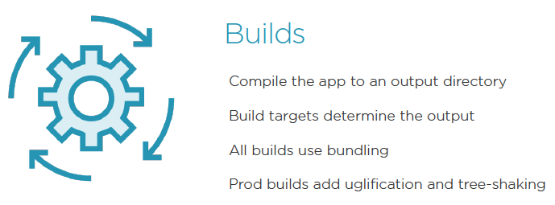
Building Angular

Slide 4
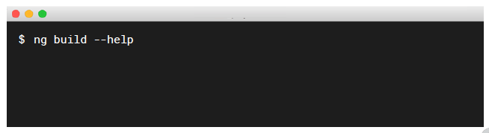
Building Angular
  Getting Help:
  Add the --help flag

Slide 5
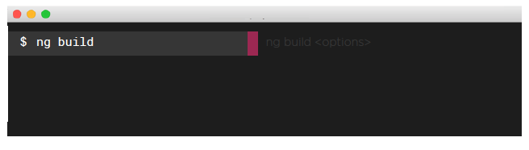
Building Angular
  Development Builds:
  Ideal for development
  Output to /dist/[your app] folder, by default

Slide 6
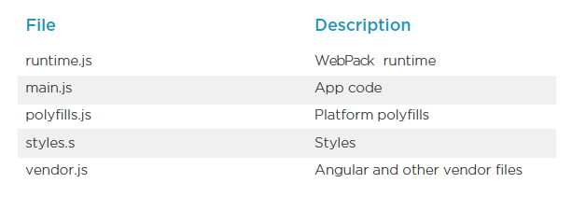
Building Angular
  Exploring the Build Bundles:

Slide 7
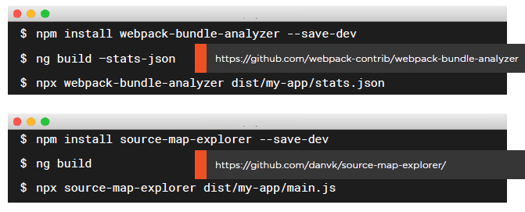
Building Angular
  Exploring the Source in the Output:

Slide 8
Demo
  ng build
  npm install webpack-bundle-analyzer --save-dev
  ng build --stats-json
npx webpack-bundle-analyzer dist/my-app/stats-es2015.json
  package.json:
  "scripts": {
  "stats": "npx webpack-bundle-analyzer dist/angular-routing/stats.json",
  npm run stats

Slide 9
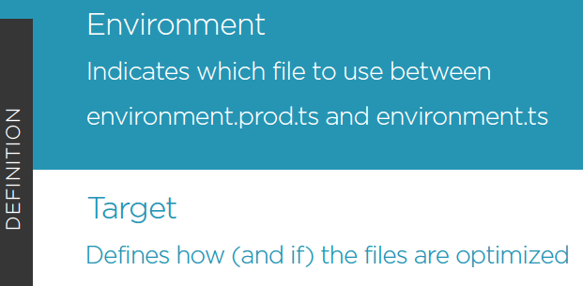
Building Targets and Environments

Slide 10
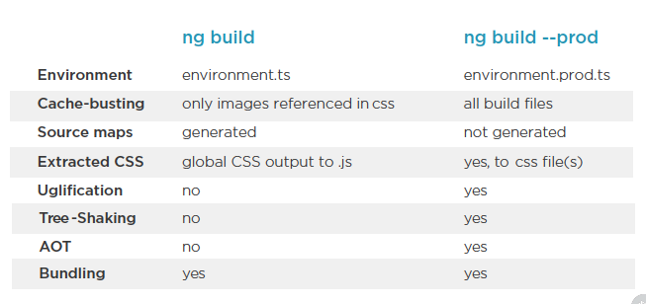
Building Targets and Environments
  Comparing Dev and Prod Build Targets:

Slide 11
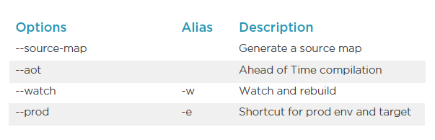
Building Targets and Environments
  Common ng build Options:

Slide 12
Demo
  ng build --aot --stats-json
  npm run stats
  ng build --help
  ng build --prod --stats-json
  npm run stats

Slide 13
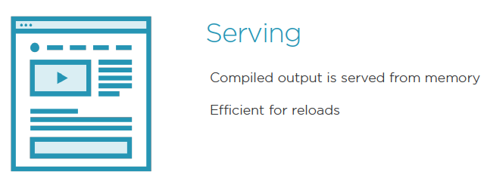
Serving Angular

Slide 14
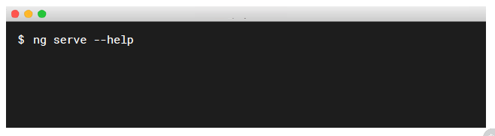
Serving Angular
  Getting Help:
  Add the --help flag

Slide 15
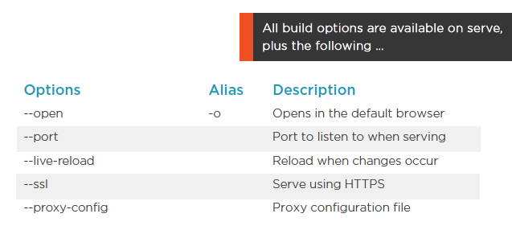
Serving Angular
  Common ng serve Options:

Slide 16
Demo
  ng serve
  ng serve --port 8888
  ng serve --live-reload false
  ng serve --prod -o

Slide 17
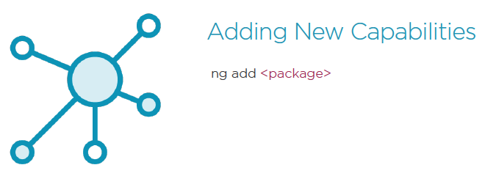
Development cycle

Slide 18
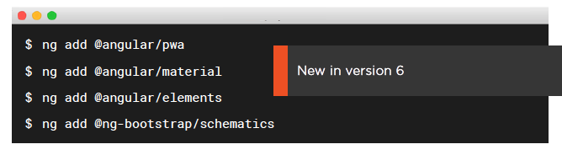
Development cycle
  ng add package:
  Adds new capabilities
  Downloads dependencies
  Update a project configuration
  Scaffold new capabilities

Slide 19
Demo
  ng add @angular/material
  ng g @angular/material:material-nav --name nav
  ng g @angular/material:material-dashboard --name dashboard
  ng g @angular/material:material-table --name customer-list

Slide 20

Development cycle

Slide 21
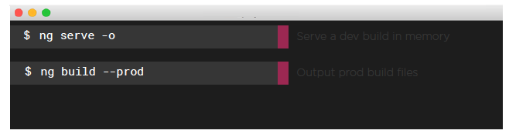
Development cycle
  Remember These Commands:
  Fast development cycles with ng serve -o
  When ready to promote your code, use ng build --prod

Slide 22
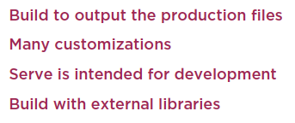
Summary

